Slide 1


Ibrahim Yazici
January, 2024

Slide 2

Outline
Executive Summary
Introduction
Methodology
Results
Conclusion
Appendix

Slide 3
Executive Summary
This report presents a comprehensive analysis of SpaceX Falcon 9 launches with the objective of predicting the outcomes of these missions. Our methodology integrates data collection, wrangling, exploratory and interactive visual analytics, culminating in predictive analysis using sophisticated classification models.
Data Collection & Wrangling: We leveraged the SpaceX API to extract relevant data on Falcon 9 launches, complemented by additional historical launch records sourced from a dedicated Wikipedia page.
Exploratory Data Analysis: Our EDA involved a blend of visualization techniques and SQL queries to unveil patterns, anomalies, and relationships within the data. This foundational analysis provided insights into the factors influencing launch success.
Visual Analytics: Utilizing the Folium library, we conducted interactive visual analytics to spatially examine the launch outcomes. By mapping the launch sites and overlaying key data points, we gained a geographical perspective of the mission successes and failures.
Predictive Analysis: Our analysis performs the construction and tuning of several classification models to predict launch outcomes. Our iterative process involved building, tuning, and evaluating the models to optimize their performance.
The findings and predictive models developed through this analysis offer a data-driven approach to enhancing the success rate of Falcon 9 booster landings.

Slide 4
Introduction
In this capstone, we will develop models to predict if the Falcon 9 first stage will land successfully.
SpaceX advertises Falcon 9 rocket launches on its website, with a cost of 62 million dollars; other providers cost upward of 165 million dollars each, much of the savings is because SpaceX can reuse the first stage.
Therefore, if we can determine if the first stage will land, we can determine the cost of a launch. This information can be used if an alternate company wants to bid against SpaceX for a rocket launch.

Slide 5

Section 1

Slide 6
Methodology
Executive Summary
Data collection methodology:
Request to the SpaceX API and clean the requested data. Also, perform web scraping to collect Falcon 9 historical launch records from a Wikipedia page.
Perform data wrangling
Convert outcomes into Training Labels with 1 means the booster successfully landed 0 means it was unsuccessful.
Perform exploratory data analysis (EDA) using visualization and SQL
Perform interactive visual analytics using Folium
Perform predictive analysis using classification models
How to build, tune, evaluate classification models

Slide 7
Data Collection
We collect and make sure the data is in the correct format from the SpaceX API.
We perform web scraping to collect Falcon 9 historical launch records from https://en.wikipedia.org/wiki/List_of_Falcon_9_and_Falcon_Heavy_launches.

Slide 8
Data Collection – SpaceX API
We make a get request to the SpaceX API.
We define helper functions that will help us use the API to extract information using identification numbers in the launch data.
GitHub URL of the completed SpaceX API calls notebook: (https://github.com/ibrahimyzc/Data-Science-Capstone/blob/main/jupyter-labs-spacex-data-collection-api.ipynb)
Request and parse the SpaceX launch data using the GET request
Use json_normalize meethod to convert the json result into a dataframe
Take a subset of our dataframe keeping only the features we want
Filter the dataframe to only include Falcon 9 launches
Deal with Missing Values
Export dataset to a CSV

Slide 9
Data Collection - Scraping
We performed web scraping to collect Falcon 9 historical launch records from a Wikipedia page titled ”List of Falcon 9 and Falcon Heavy launches”
GitHub URL of the completed web scraping notebook: (https://github.com/ibrahimyzc/Data-Science-Capstone/blob/main/jupyter-labs-webscraping.ipynb)
lmport required packages and provide some helper functions to process web scraped HTML table
Perform an HTTP GET method to request the Falcon9 Launch HTML page, as an HTTP response
Create a BeautifulSoup object from the HTML response
Extract all column/variable names from the HTML table header
Create a dataframe from parsed values
Export the dataframe to a CSV

Slide 10
Data Wrangling
We perform some Exploratory Data Analysis (EDA) to find some patterns in the data and determine what would be the label for training supervised models.
GitHub URL for the data wrangling notebook: (https://github.com/ibrahimyzc/Data-Science-Capstone/blob/main/labs-jupyter-spacex-Data%20wrangling.ipynb)
There are several different cases where the booster did not land successfully. We will convert those outcomes into Training Labels with 1 and 0
Calculate the number of launches on each site
Calculate the number and occurrence of each orbit
Calculate the number and occurence of mission outcome of the orbits
Create a landing outcome label from Outcome column

Slide 11
EDA with Data Visualization
We perform exploratory some Data Analysis and Feature Engineering tasks:
Visualize the relationship between Flight Number and Launch Site
Visualize the relationship between Payload and Launch Site
Visualize the relationship between success rate of each orbit type
Visualize the relationship between FlightNumber and Orbit type
Visualize the relationship between Payload and Orbit type
Visualize the launch success yearly trend
Create dummy variables to categorical columns
Cast all numeric columns to `float64`
GitHub URL: (https://github.com/ibrahimyzc/Data-Science-Capstone/blob/main/jupyter-labs-eda-dataviz.ipynb.jupyterlite.ipynb)

Slide 12
EDA with SQL
We execute SQL queries to perform the following tasks:
Display the names of the unique launch sites in the space mission
Display 5 records where launch sites begin with the string 'CCA'
Display the total payload mass carried by boosters launched by NASA (CRS)
Display average payload mass carried by booster version F9 v1.1
List the date when the first succesful landing outcome in ground pad was acheived.
List names of the booster_versions which have carried the maximum payload mass.
GitHub URL: (https://github.com/ibrahimyzc/Data-Science-Capstone/blob/main/jupyter-labs-eda-sql-coursera_sqllite.ipynb)

Slide 13
Build an Interactive Map with Folium
We performed interactive visual analytics using Folium:
Create and add folium.Circle and folium.Marker for each launch site on the site map to explore the map by zoom-in/out the marked areas
Mark the success/failed launches for each site on the map
Calculate the distances between a launch site to its proximities
Add Mouse Position to get the coordinate (Lat, Long) for a mouse over on the map
Create a marker with distance to a closest city, railway, highway, etc.
Draw a line between the marker to the launch site
GitHub URL: (https://github.com/ibrahimyzc/Data-Science-Capstone/blob/main/lab_jupyter_launch_site_location.jupyterlite.ipynb)

Slide 14
Predictive Analysis (Classification)
We performed exploratory Data Analysis and determine Training Labels:
Create a column for the class
Standardize the data
Split into training data and test data
We determined best Hyperparameter for SVM, Classification Trees and Logistic Regression
We discovered the method performs best using test data
GitHub URL: (https://github.com/ibrahimyzc/Data-Science-Capstone/blob/main/SpaceX_Machine_Learning_Prediction_Part_5.jupyterlite.ipynb)
Standardize the data
Split the data into training and test data
Create a dataframe from parsed values
Create a logistic regression object then create a GridSearchCV to find the best parameters
Calculate the accuracy on the test data using the method score
Repeat the same process for support vector machine, decision tree classifier, and k nearest neighbors.
Find the method performs best using the test data

Slide 15

Section 2

Slide 16
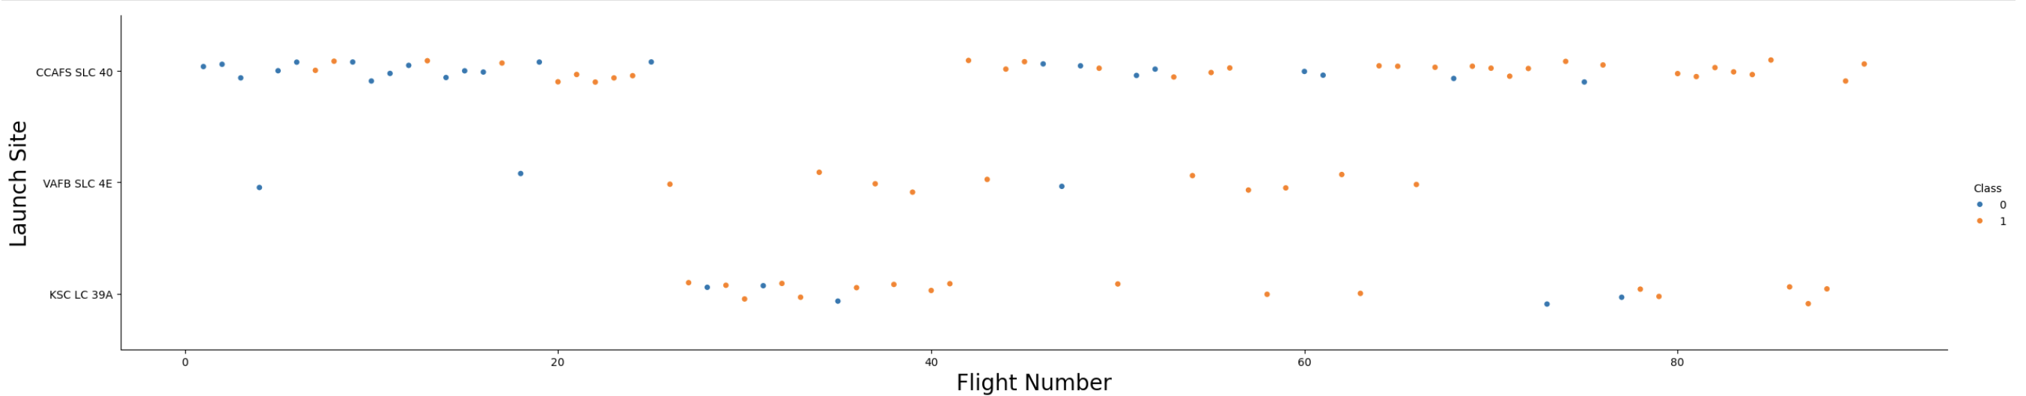
Flight Number vs. Launch Site
Different launch sites have different success rates. CCAFS LC-40, has a success rate of 60 %, while KSC LC-39A and VAFB SLC 4E has a success rate of 77%. Below, let's drill down to each site visualize its detailed launch records.

Slide 17
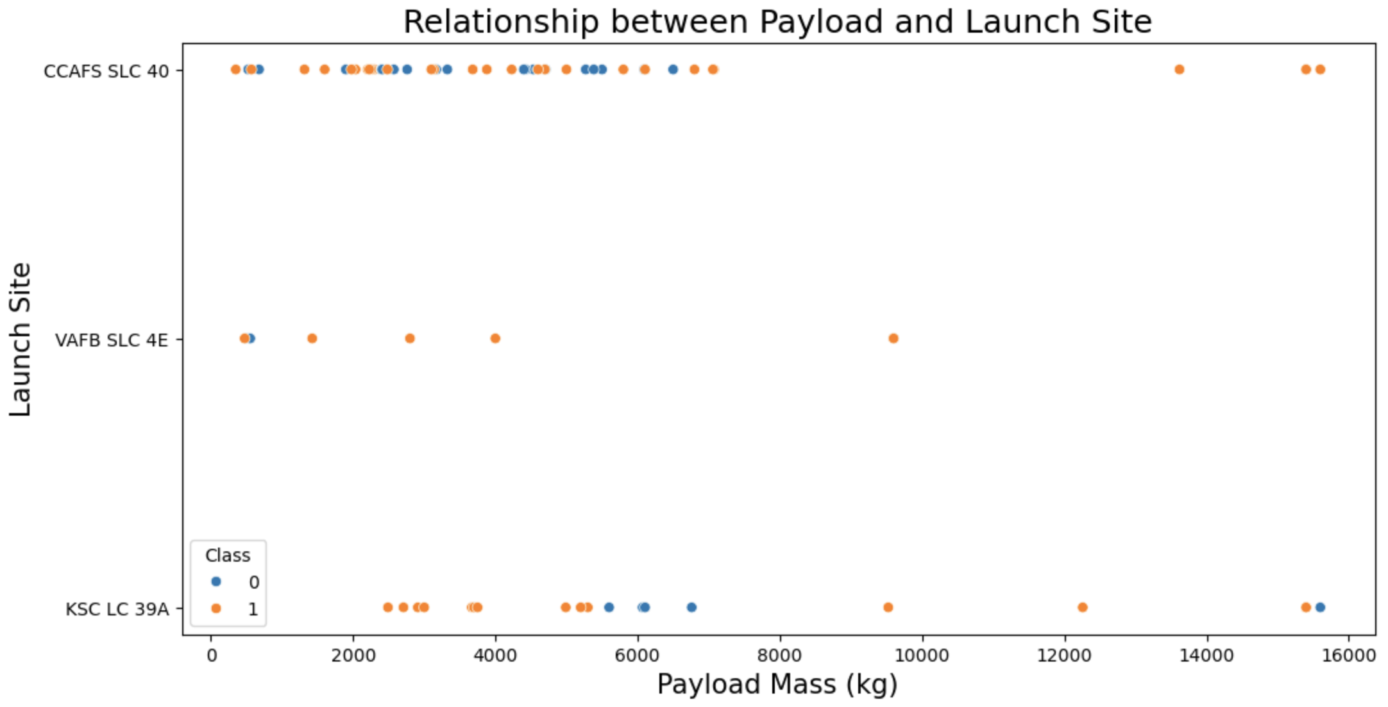
Payload vs. Launch Site
We want to observe if there is any relationship between launch sites and their payload mass. Scatter point chart shows for the VAFB-SLC launchsite there are no rockets launched for heavypayload mass(greater than 10000).

Slide 18
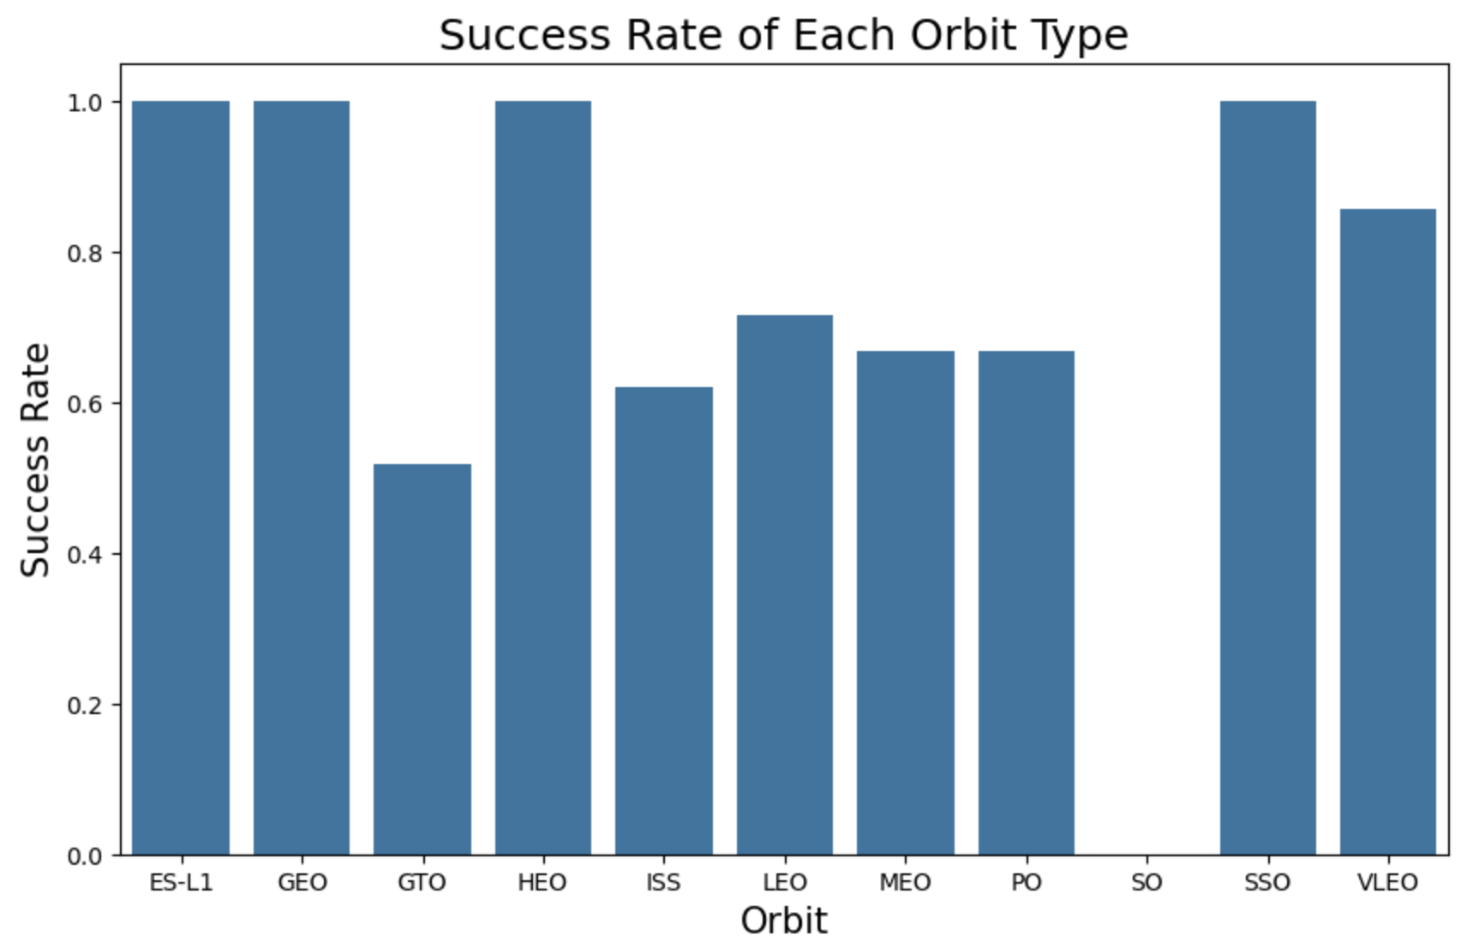
Success Rate vs. Orbit Type
We want to visually check if there are any relationship between success rate and orbit type using a bar chart.

Slide 19
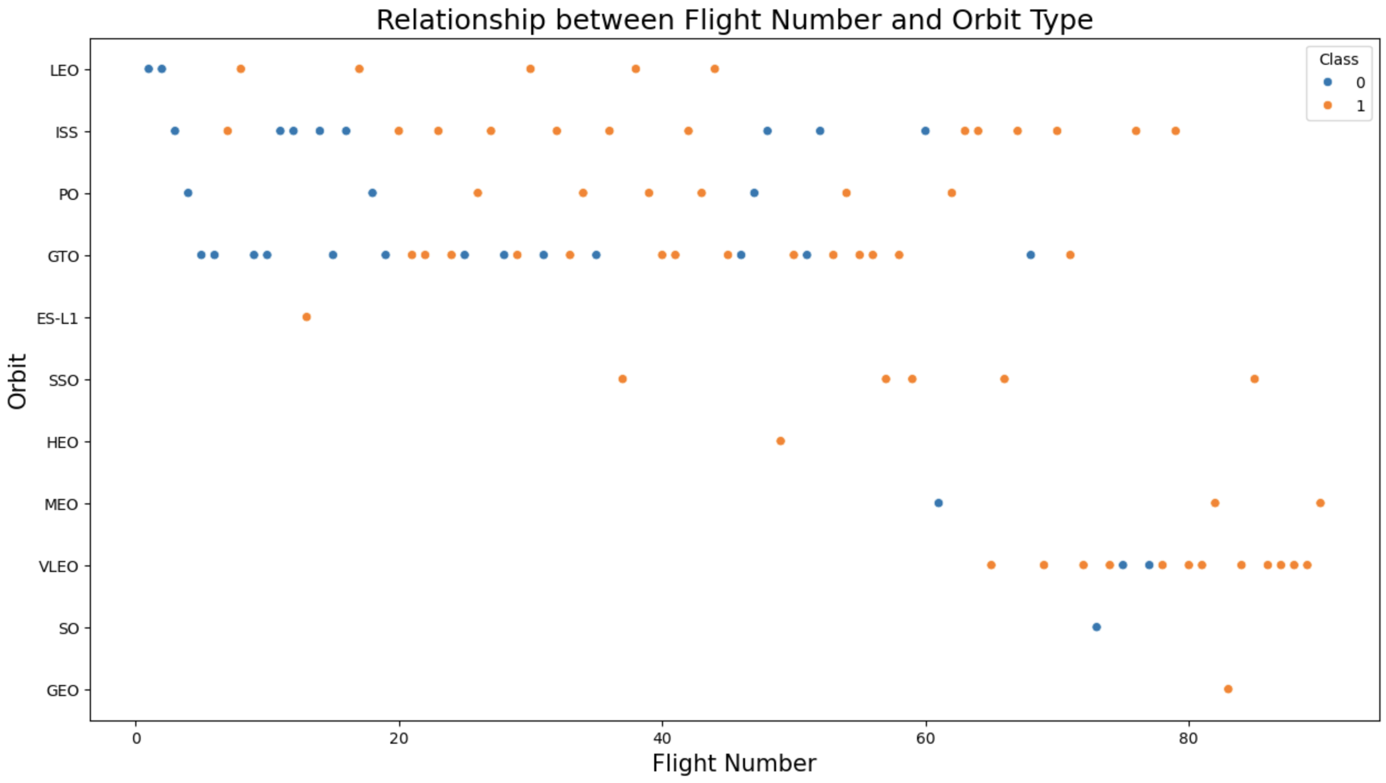
Flight Number vs. Orbit Type
We see that in the LEO orbit the Success appears related to the number of flights; on the other hand, there seems to be no relationship between flight number when in GTO orbit.

Slide 20
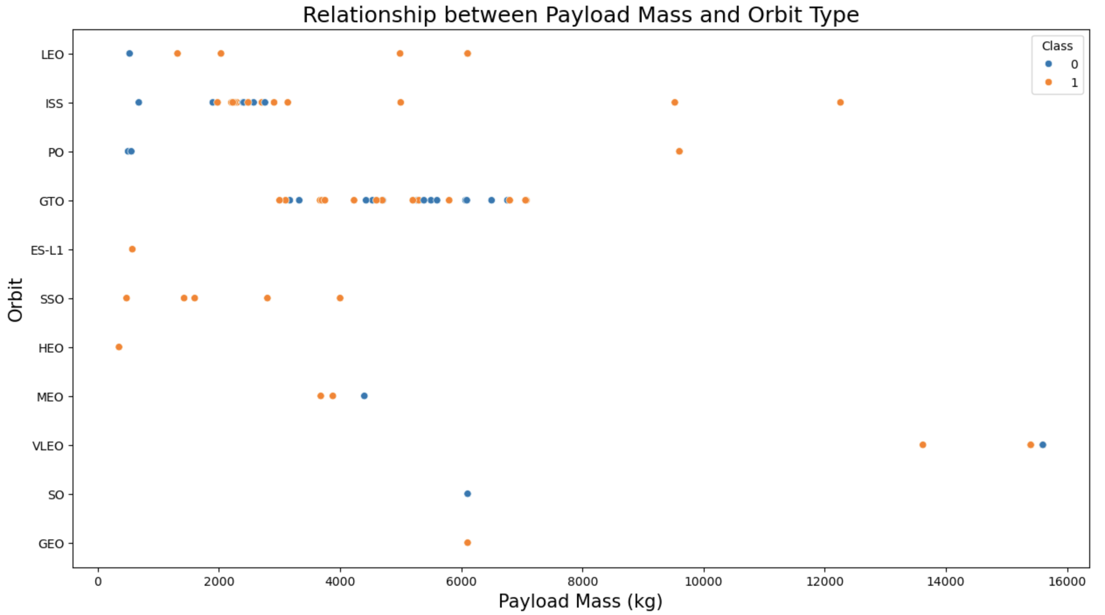
Payload vs. Orbit Type
With heavy payloads the successful landing or positive landing rate are more for Polar,LEO and ISS.
For GTO we cannot distinguish this well as both positive landing rate and negative landing(unsuccessful mission) are both there.

Slide 21
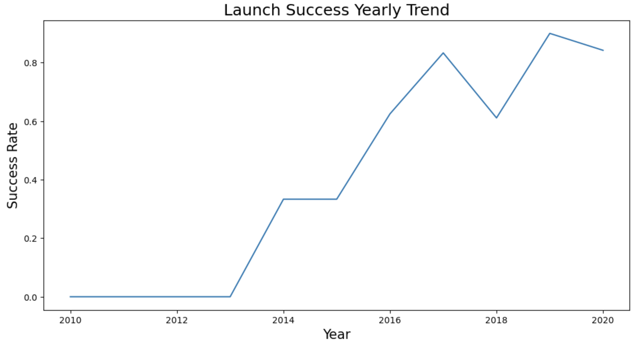
Launch Success Yearly Trend
We visualize the launch success yearly trend

Slide 22
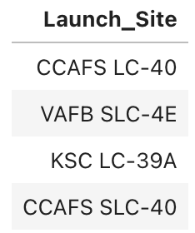
All Launch Site Names
Display the names of the unique launch sites in the space mission.

Slide 23
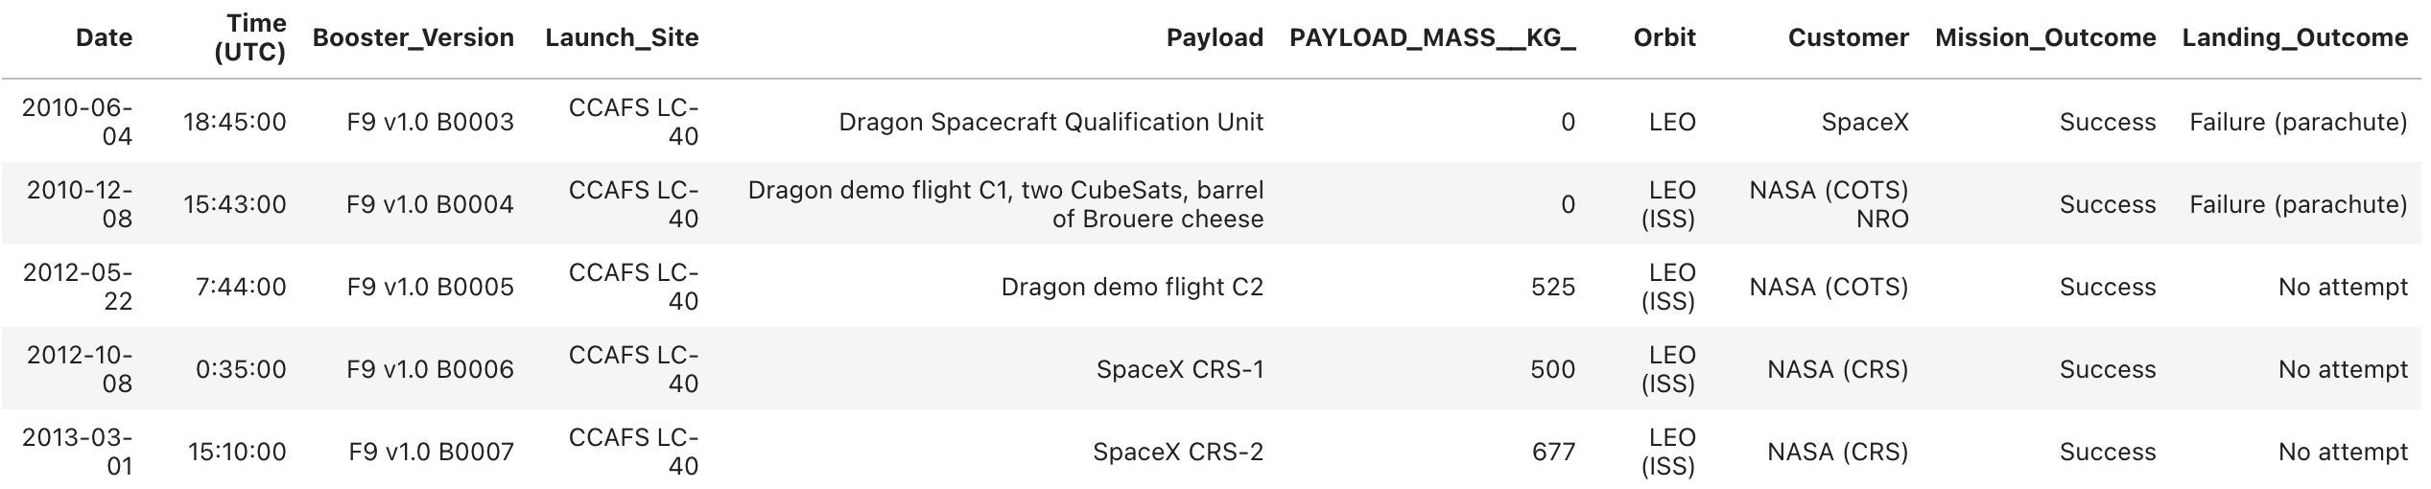
Launch Site Names Begin with 'CCA'
Display 5 records where launch sites begin with the string 'CCA'

Slide 24
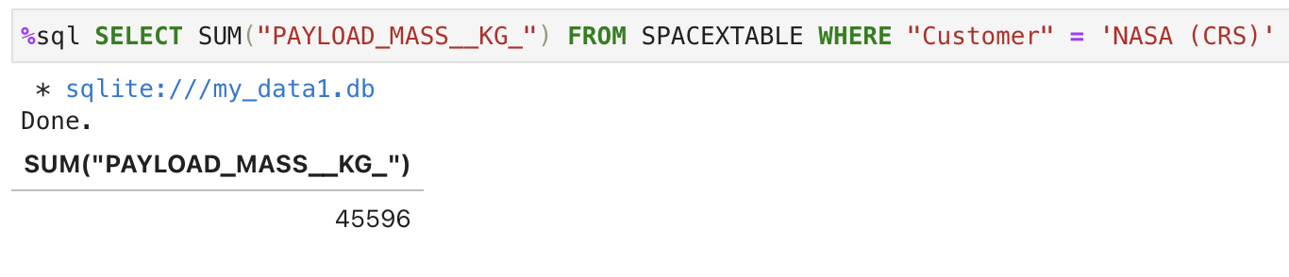
Total Payload Mass
Display the total payload mass carried by boosters launched by NASA (CRS)

Slide 25
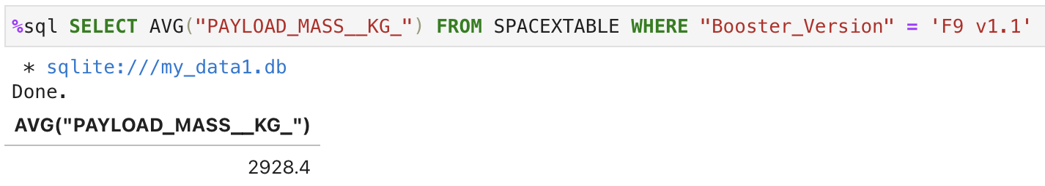
Average Payload Mass by F9 v1.1
Display average payload mass carried by booster version F9 v1.1

Slide 26
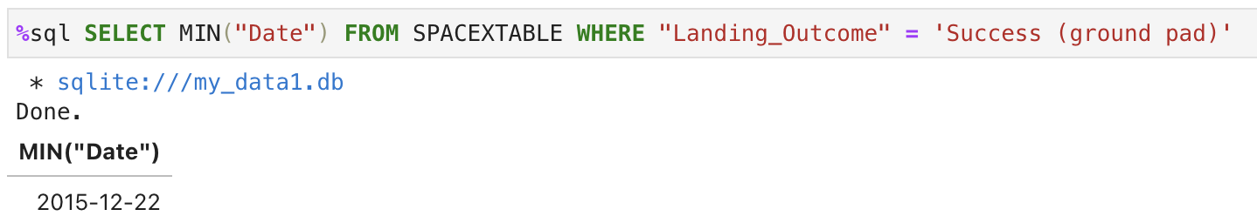
First Successful Ground Landing Date
List the date when the first succesful landing outcome in ground pad was acheived.

Slide 27
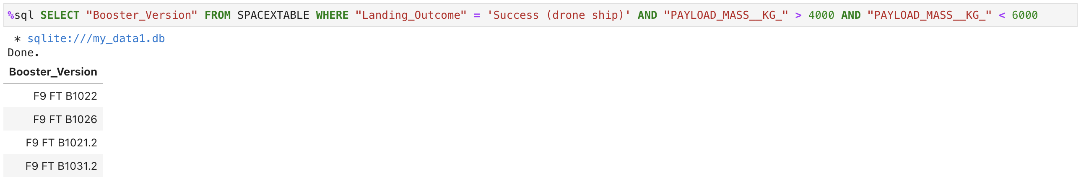
Successful Drone Ship Landing with Payload between 4000 and 6000
List the names of the boosters which have success in drone ship and have payload mass greater than 4000 but less than 6000

Slide 28
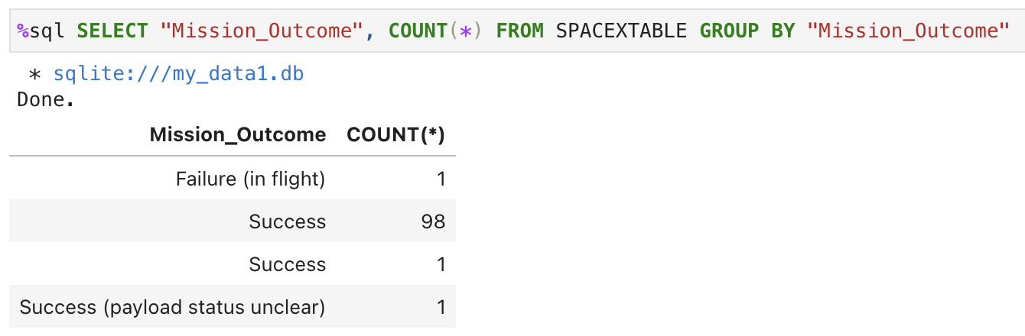
Total Number of Successful and Failure Mission Outcomes
List the total number of successful and failure mission outcomes

Slide 29
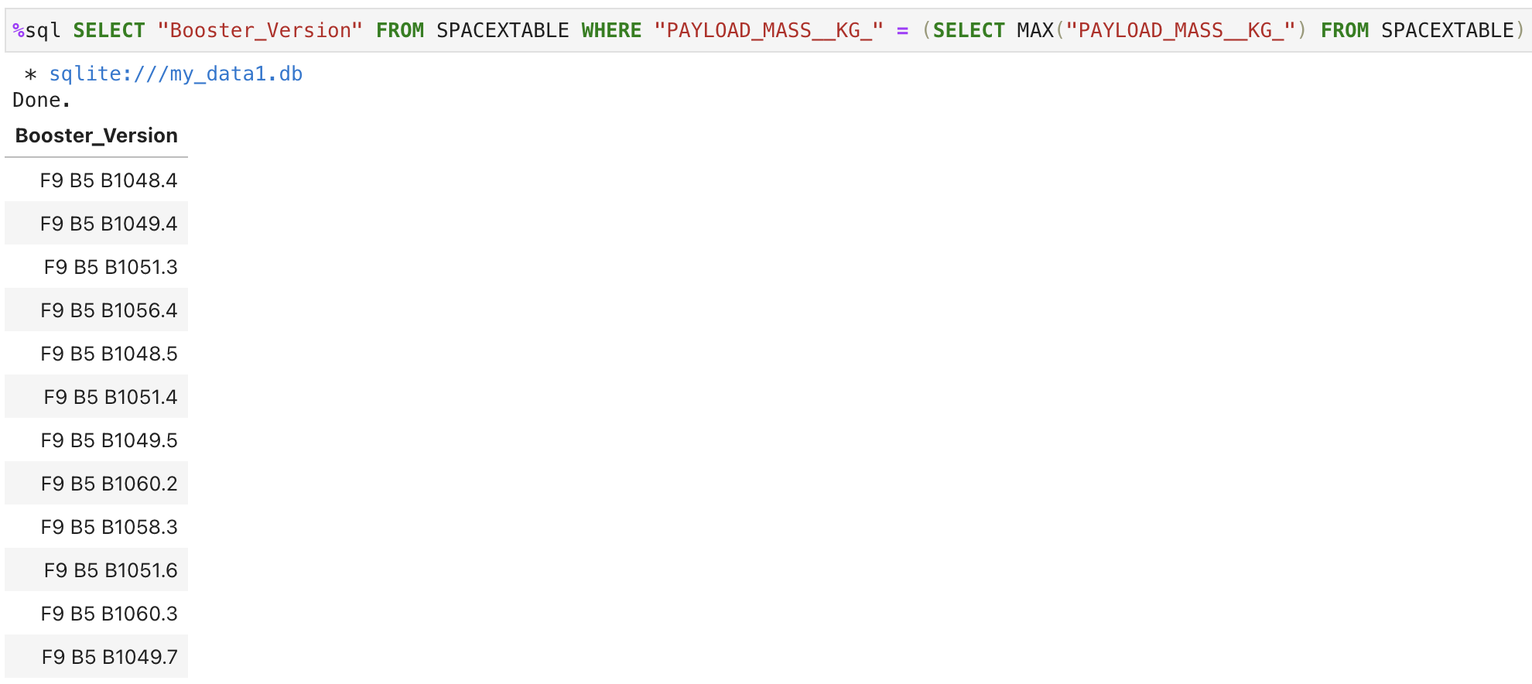
Boosters Carried Maximum Payload
List the names of the booster_versions which have carried the maximum payload mass.

Slide 30
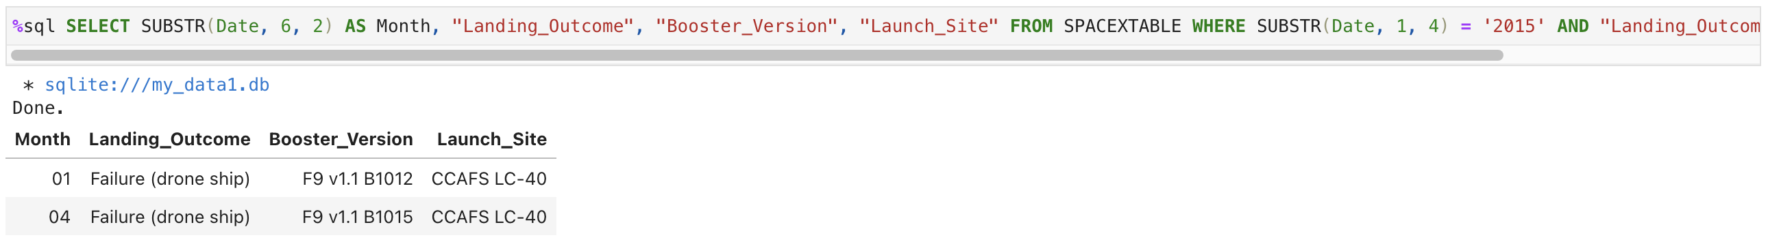
2015 Launch Records
List the records which will display the month names, failure landing_outcomes in drone ship ,booster versions, launch_site for the months in year 2015

Slide 31
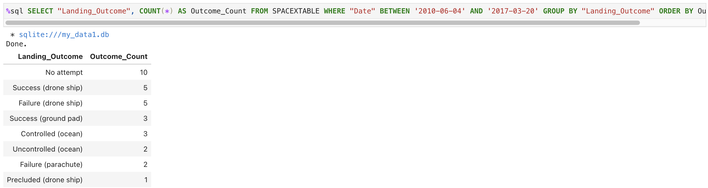
Rank Landing Outcomes Between 2010-06-04 and 2017-03-20
Rank the count of landing outcomes (such as Failure (drone ship) or Success (ground pad)) between the date 2010-06-04 and 2017-03-20, in descending order.

Slide 32

Section 3

Slide 33
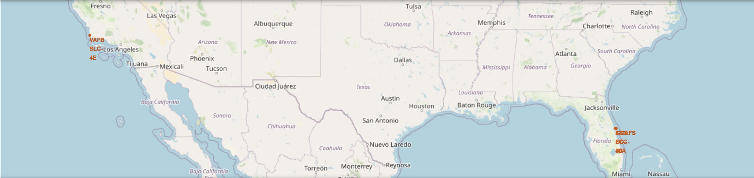
<Mark all launch sites on a map>
We add each site's location on a map using site's latitude and longitude coordinates.
We can explore the map by zoom-in/out the marked areas , and try to answer the following questions:
Are all launch sites in proximity to the Equator line?
Are all launch sites in very close proximity to the coast?

Slide 34
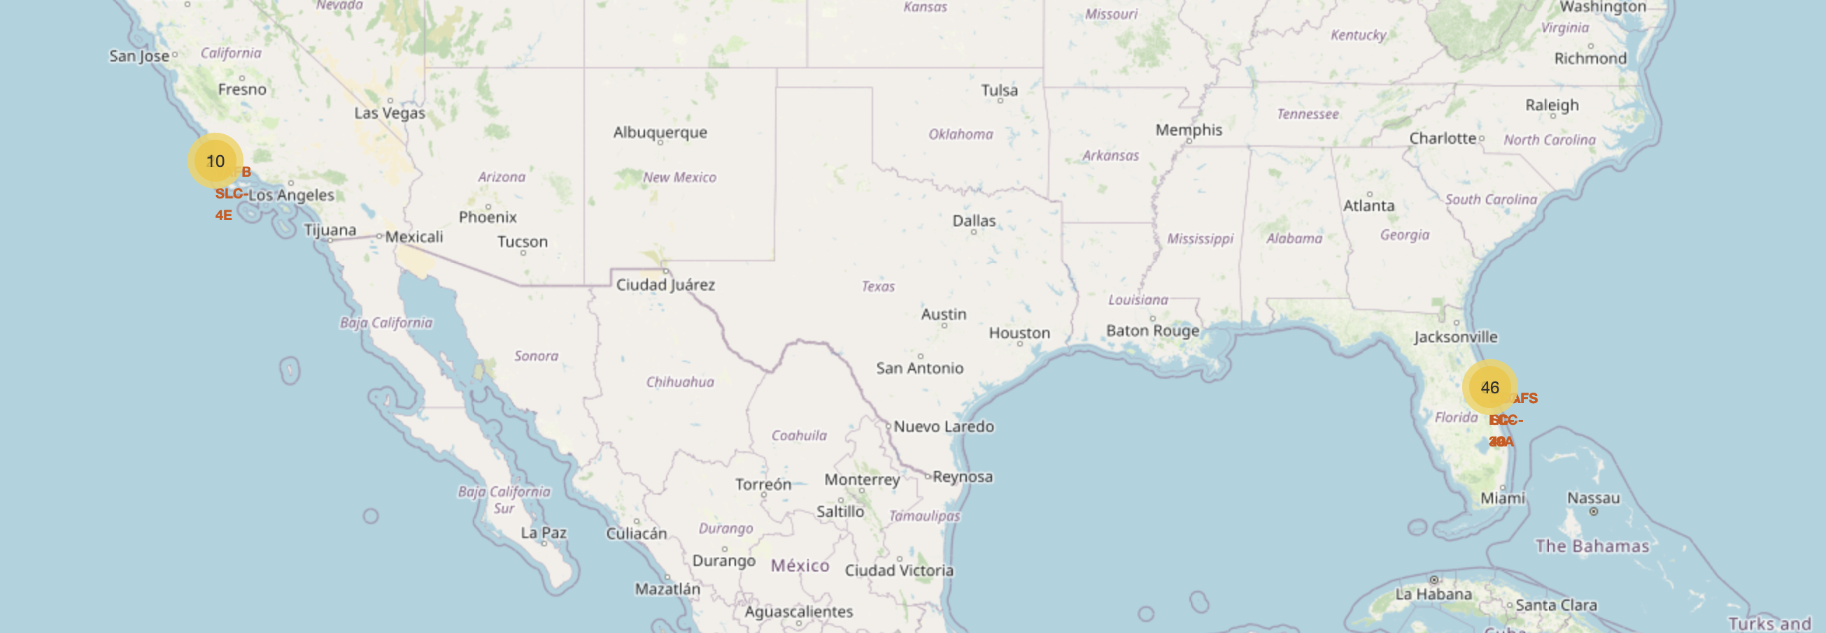
<Mark the success/failed launches for each site on the map>
Enhance the map by adding the launch outcomes for each site, and see which sites have high success rates.

Slide 35
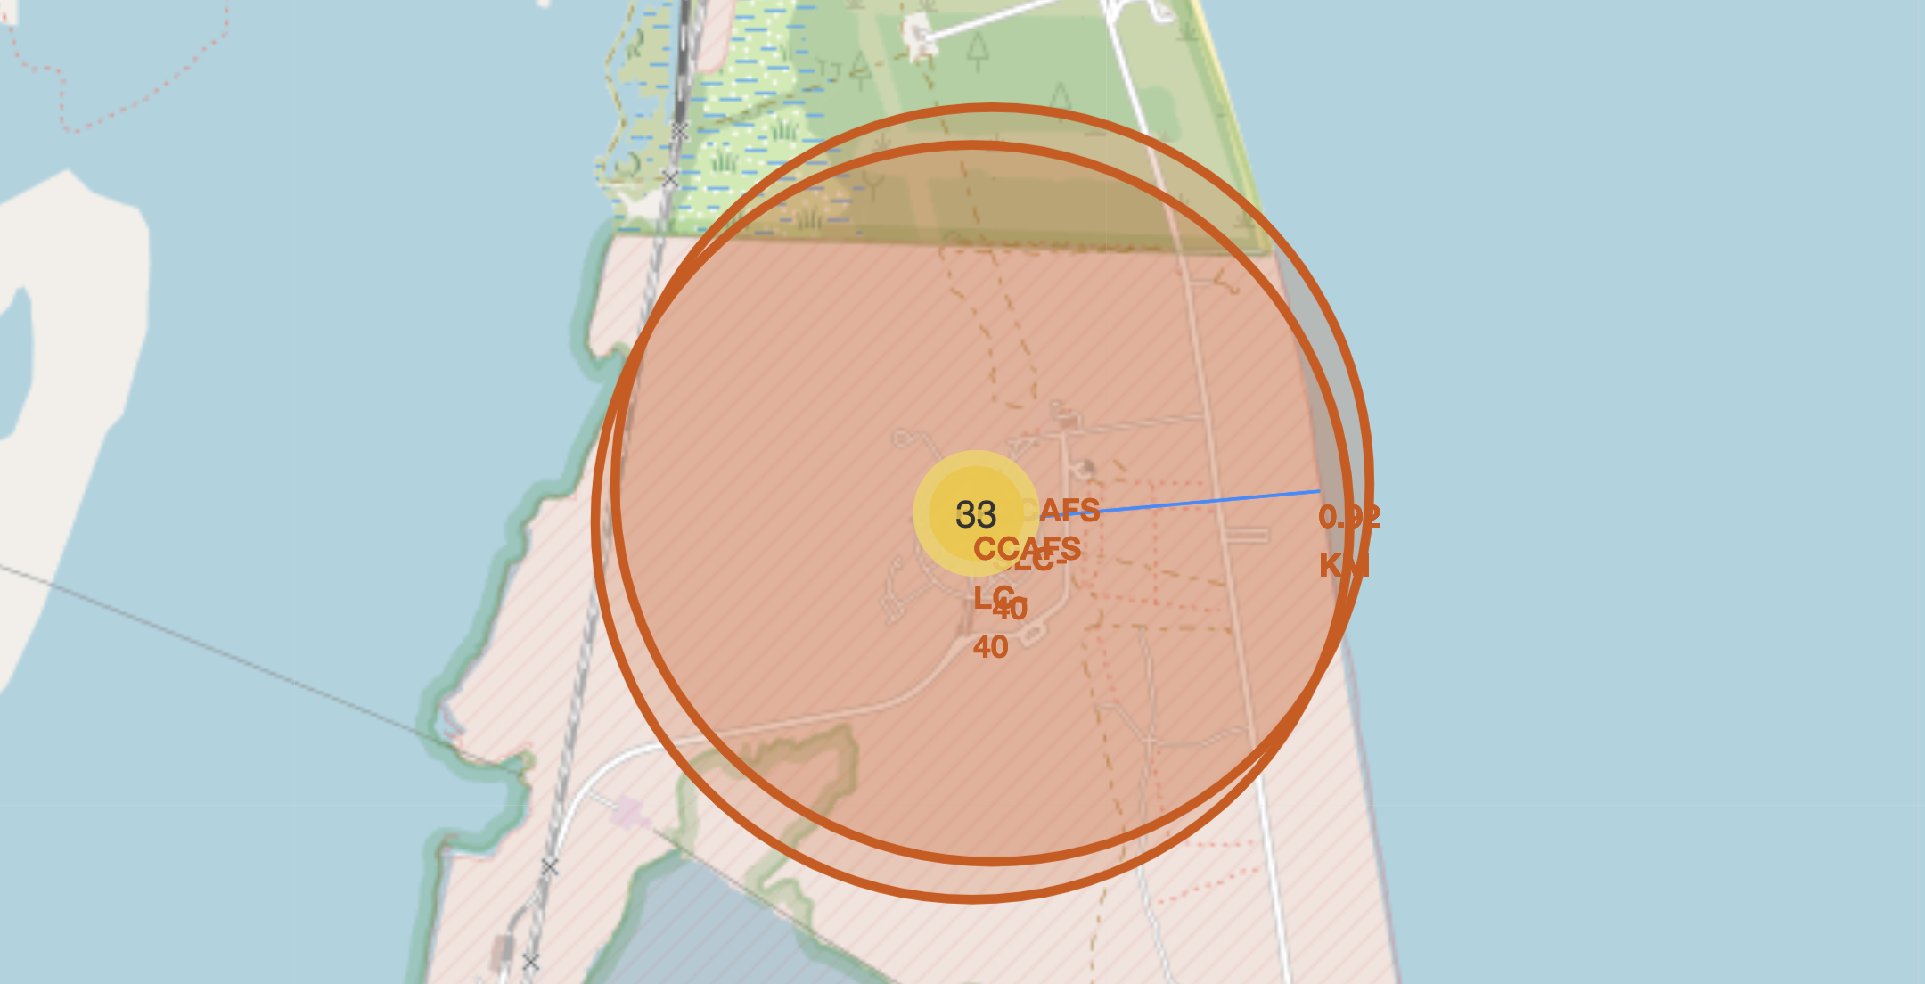
<Calculate the distances between a launch site to its proximities>
We zoom in to a launch site and explore its proximity to see if you can easily find any railway, highway, coastline, etc.
We move the mouse to these points and mark down their coordinates in order to the distance to the launch site. Below, the proximity to the coastline is shown on the map as an example.

Slide 36

Section 4

Slide 37
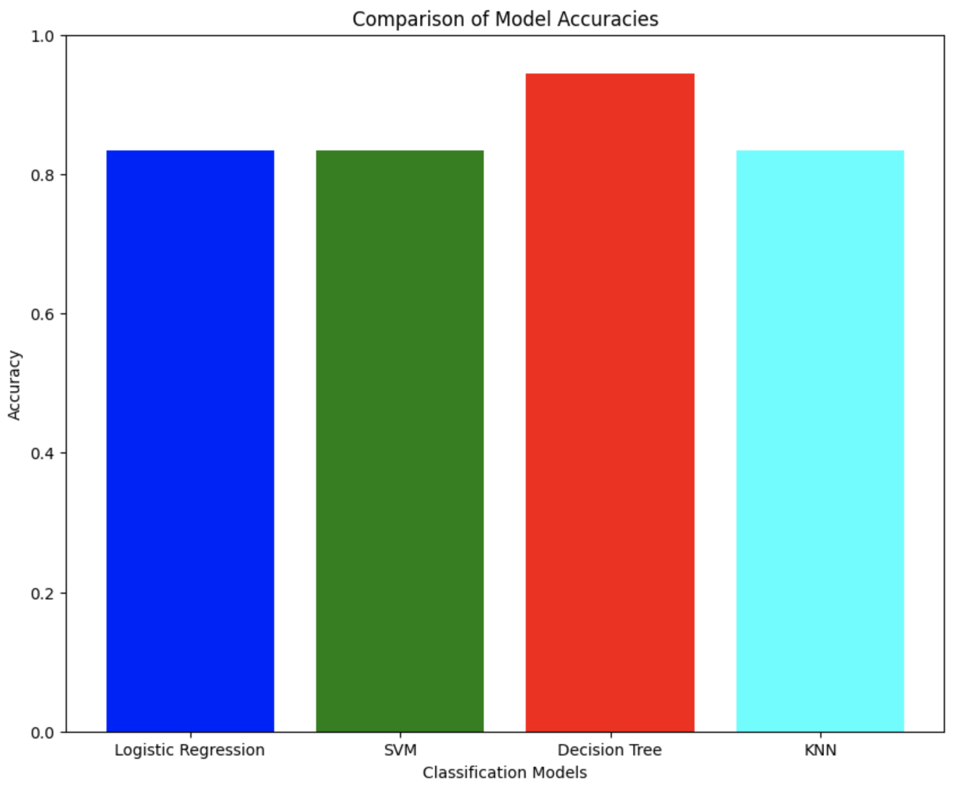
Classification Accuracy
Decision tree model has the highest model accuracy with 0.944 on the test data.

Slide 38
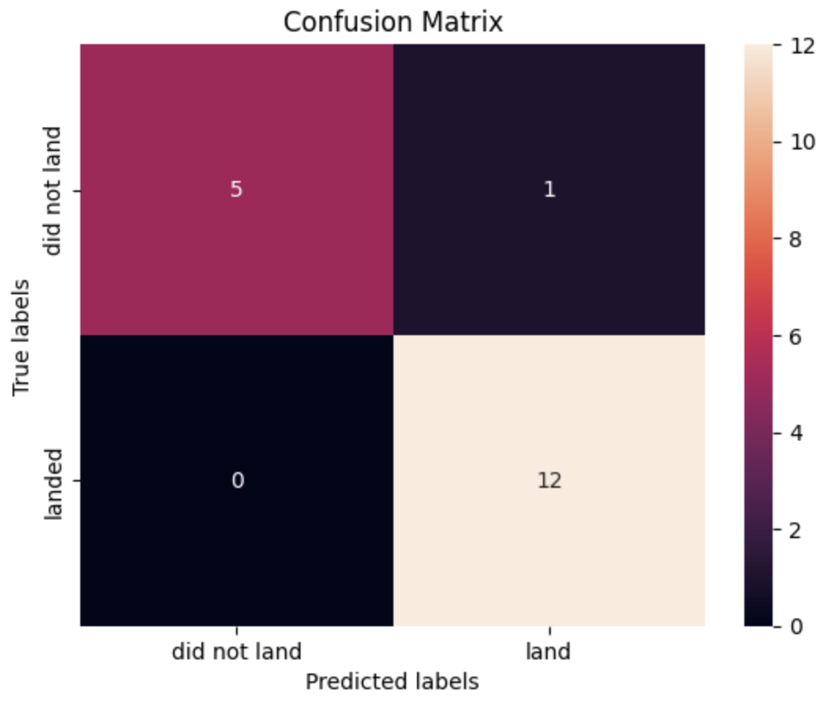
Confusion Matrix for the Decision Tree Model
Examining the confusion matrix, we see that decision tree model can effectively distinguish between the different classes.

Slide 39
Conclusions
Decision tree is the best performing model among the four models tested.
Its tuned hpyerparameters are: {'criterion': 'entropy', 'max_depth': 12, 'max_features': 'sqrt', 'min_samples_leaf': 4, 'min_samples_split': 5, 'splitter': 'random’}. Its accuracy on the train set is 0.87321.
By the confusion matrix, we can conclude:
The model is quite good at predicting when a launch will land successfully, with 12 true positives.
It has a small number of false positives, with only 1 instance where it predicted a landing would occur when it did not.
There are no false negatives; the model did not miss any landings.
The model has 5 true negatives, correctly identifying 5 instances where the launch did not land.
The remaining 3 models, Logistic Regression, SVM and, KNN displayed similar performances according to the accuracy values.

Slide 40
Appendix
All the files related to this project can be found at:
<https://github.com/ibrahimyzc/Data-Science-Capstone/tree/main>

Slide 41


